Slide 1
Self-Reflection
Each person should take out a piece of paper and answer the following two questions:
When I want to show my parents/children I appreciate them I usually____.
I feel most loved by ____(parent/child on call) when ______.

Slide 2
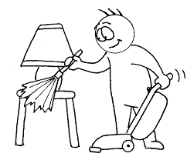
The 5 Love Languages
1. Words – People who speak this love language feel loved when others speak intentional and sincere words, complimenting and encouraging them.
2. Acts of service – People who speak this love language feel loved when others do something that is kind, intentional, and unexpected that helps them.
3. Gifts – People who speak this love language feel loved when others give them a gift that is personal and thoughtful.

Slide 3
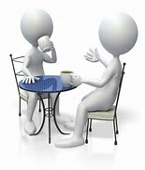
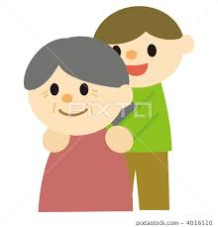
The 5 Love Languages Continued
4. Quality time - People who speak this love language feel loved when others intentionally and deliberately spend time with them.
5. Touch – People who speak this love language feel loved through meaningful physical contact.

Slide 4
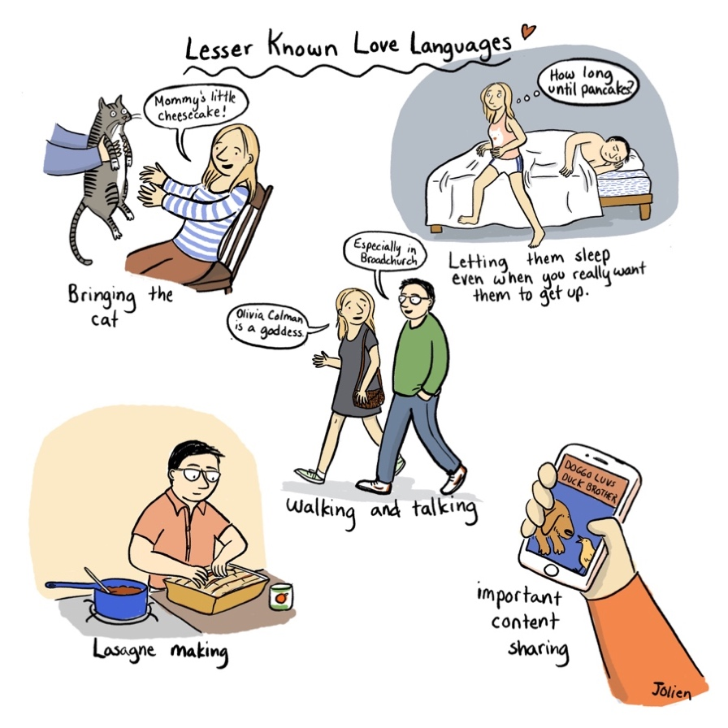

Slide 5
SCORING
C
A
= WORDS, SPEAKING
= THOUGHTFUL GIFTS
D
= ACTS OF SERVICE, DOING
B
= QUALITY TIME
E
= PHYSICAL TOUCH

Slide 6
Parent-Child Discussion Questions
Share your respective love languages (which will also be the parent’s names on the Zoom screens).
What is one thing that surprised you about what you just learned about your parent/child? How did what you learned compare with the love language you thought your parent/child spoke?
What is one thing you could each do differently over the next week or two with your child/parent now that you know each other’s love languages?

Slide 7
One Final Thought…
“With full love tanks people can process conflicts, create a positive emotional climate, and work together, support, and encourage each other.”
- Gary Chapman
…even more important in today’s world!

Slide 8
Take Home Questions
If you had to map or guess at the love languages of every member of your immediate family – what would you guess? How does it feel to look at the range of love languages in your family?
Now that you know each others’ love languages and have a few new ideas about ways to show love to each other over the next few weeks, consider the following question with your parent/child: What is a way we can show our love to the wider world (our community, our congregation, etc.) right now?

